Slide 1


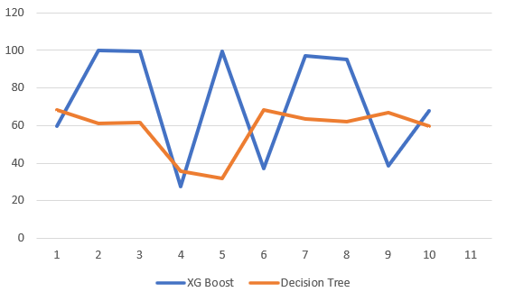
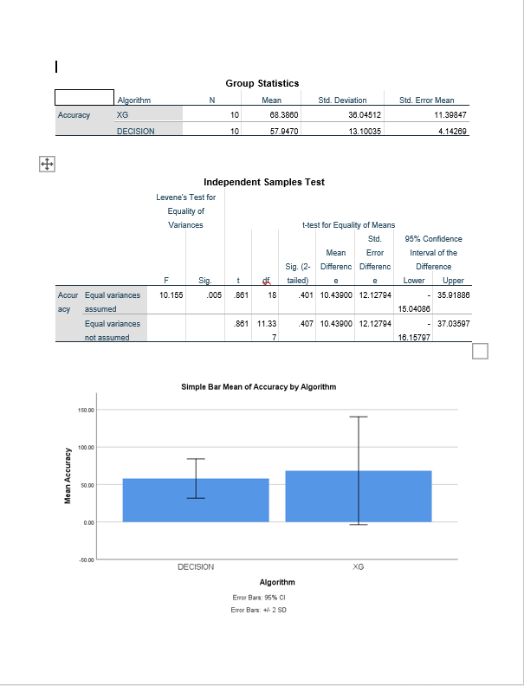
Name : S .Ashish Kumar
Register number:192124142
Guided by : Dr . A .Muniyappan
Enhancing Accuracy in Textile Production Forecasting : A Comparative Analysis of XG Boost And Decision Tree
INTRODUCTION
Machine learning offers a experienced and refined approach to textile production forecasting, leveraging algorithms to learn from vast datasets and identify hidden patterns.
XGBoost is renowned for its gradient boosting framework, while Decision Tree offers a well-established and interpretable approach to classification and regression tasks.
The transformative potential of machine learning to revolutionize textile production forecasting.
Two groups were analyzed in this research.
Group 1: XGBoost Algorithm,
Group 2: Decision Tree Algorithm.
The ability to predict production outcomes with pinpoint accuracy empowers manufacturers on multiple fronts.
Traditional statistical methods often struggle to capture intricate relationships within the complex system of textile production.
Textile production forecasting plays a pivotal role in optimizing resource allocation, inventory management, and overall operational efficiency.
The exploration of these algorithms aims to provide industry professionals and researchers with a nuanced understanding of their respective strengths and weaknesses, ultimately guiding the selection of the most suitable model for this specific application.
Predicting Textile production
Re-iterate till satisfactory model performance
MATERIALS AND METHODS
Data assets
Data Retrieval
Machine
Learning
Algorithm
Data preparation
Data processing &
Wrangling
Feature
Extraction &
Engineering
Feature
Scaling &
Selection
Modelling
Model
Evaluation&
Tuning
Deployment &
Monitoring
RESULTS
Algorithm statistics of XG Boost And Decision Tree
 | Group | N | Mean | Std. Deviation | Std. Error Mean
Accuracy | XG Boost | 10 | 68.3860 | 36.04512 | 11.39847
 | Decision Tree | 10 | 57.9470 | 13.10035 | 4.14269
First Accuracy Graph
XG Boost vs Decision Tree
It shows the accuracy of XG Boost is 68.3860 and accuracy of Decision Tree is 57.9470. X- axis denotes XG Boost Vs Decision Tree Y-axis denotes mean accuracy, with error bars indicating ±2 SD.
DISCUSSION AND CONCLUSION
The XGBoost algorithm achieved a significantly higher accuracy score of 68.38% compared to the Decision Tree algorithm's 57.94% in the context of textile production forecasting.
XGBoost's advanced regularization techniques, prevention of overfitting, and utilization of multiple CPU cores contribute to enhanced performance and speed, crucial for real-world textile production forecasting scenarios.
The comparative analysis between XGBoost and Decision Tree algorithms in textile production forecasting clearly demonstrates the superior performance of XGBoost in terms of accuracy and predictive capabilities
T-test Statistical analysis reveals a significance value of p=0.001 (independent sample T-test p<0.05), signifying a statistically significant difference between the two groups.
The enhanced performance, speed, and accuracy of XGBoost make it a valuable tool for optimizing resource allocation, improving inventory management, and enhancing operational efficiency in textile production forecasting scenarios.
The lower accuracy of Decision Tree suggests that, in certain scenarios, more advanced algorithms like XGBoost may offer better predictive performance, underscoring the importance of algorithm selection.
BIBLIOGRAPHY
Horowitz, A. Simplifications for single-route transit-ridership forecasting models. Transportation 1984, 12, 261–275.
Taylor, B.; Miller, D.; Iseki, H.; Fink, C. Nature and/or nurture? Analyzing the determinants of transit ridership across US urbanized areas. Transp. Res. Part A Policy Pract. 2009, 43, 60–77.
Chan, S.; Miranda-Moreno, L. A station-level ridership model for the metro network in Montreal, Quebec. Can. J. Civ. Eng. 2013, 40, 254–262.
Idris, A.; Habib, K.; Shalaby, A. An investigation on the performances of mode shift models in transit ridership forecasting. Transp. Res. Part A Policy Pract. 2015, 78, 551–565.
Zhao, J.; Deng, W.; Song, Y.; Zhu, Y. Analysis of Metro ridership at station level and station-to-station level in Nanjing: An approach based on direct demand models. Transportation 2014, 41, 133–155.
Sillanpää V, Liesiö J (2018) Forecasting replenishment orders in retail: value of modelling low and intermittent consumer demand with distributions. Int J Prod Res 56(12):4168–4185
Mohammed A (2020) Towards ‘gresilient’ supply chain management: a quantitative study. Resour Conserv Recycl 155:104641
Oliva R, Watson N (2009) Managing functional biases in organizational forecasts: a case study of consensus forecasting in supply chain planning. Prod Oper Manag 18(2):138–151

